Slide 1
Arm-flex Based biometrics based on fusion of Dynamic time wrap and Cross Correlation
Abhijeet Borgule
Ubiquitous computing class 2014

Slide 2
Proposed Algorithm:-
Start
Record Phone Pickup Activity
Coordinates
X
Y
Z
Gravity
Signal segmentation
Until gravity falls at minimum value
Enhancement
Dynamic Time Warp
Cross Correlation
Recorded Dataset
If threshold match
User Authentication Successful
Stop

Slide 3
Data Acquisition:-
In first, Using AndroSensor application the data is collected.
The collected data consist of phone pick up activity.
X,Y and Z parameters are extracted from.
The collected data is converted to .MAT file for the Matlab software environment.
And further experiment is performed on *.Mat file.

Slide 4
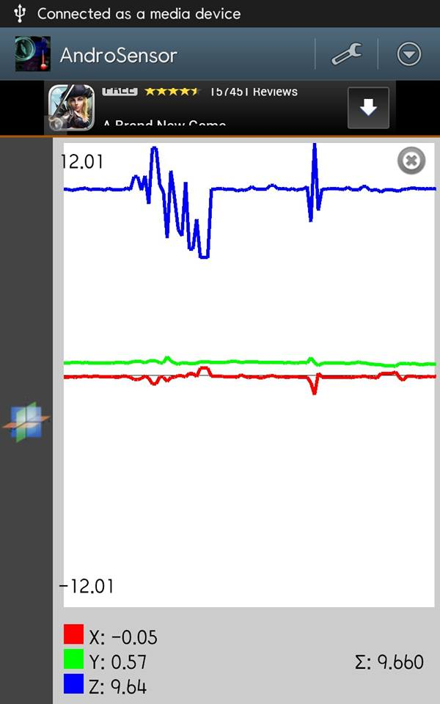
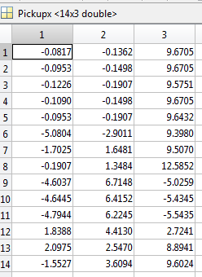

Data Acquisition:-
Data Acquisition using AndroSensor

Slide 5
Signal Segmentation
In here, we observed the gravity parameter Z and their values while call pickup process.
we can conclude is that the values of Z is decreases due to accelerometer is heading against the gravity.
From beginning to the certain minimum point we segment the signal.
The min value is selected from vector Z and from the beginning point is signal is segmented.

Slide 6
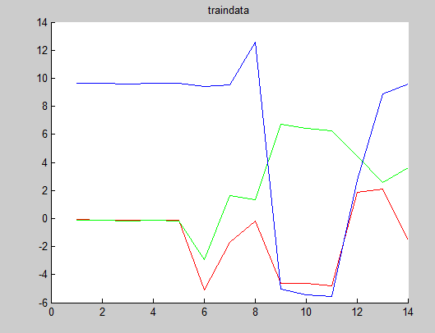
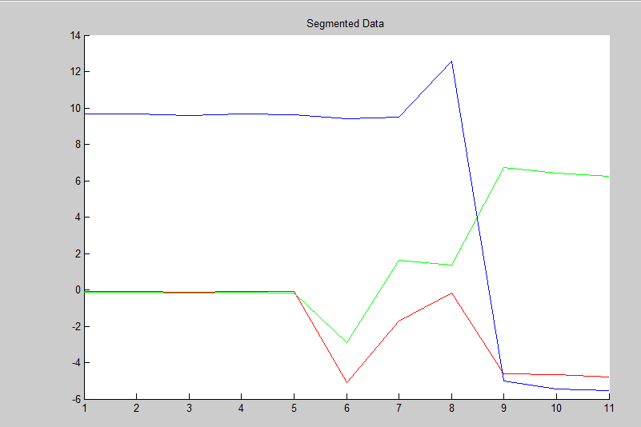
Signal Segmentation
Training Data
Signal Segmentation
Red=X
Green=Y
Blue=Z
The Test data also processed same way.

Slide 7
Dynamic Time warp:-
Dynamic Time Warping algorithm is applied to compute similarity of between those signals.
Where, D(i,j) is a distance matrix
is distance each between two
points in V and W
cost=norm(s(i)-t(j));
%D(i,j)=min(D(i-1,j-1)+cost, D(i-1,j)+cost*0.5, D(i,j-1)+cost*0.5);
D(i+1, j+1)= cost + min([D(i,j+1), D(i+1,j), D(i,j)]);

Slide 8
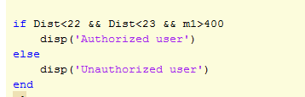
Cross Correlation:-
In signal processing, cross-correlation is a measure of similarity of two waveforms as a function of a time-lag applied to one of them.
This is also known as a sliding dot product or sliding inner-product. It is commonly used for searching a long signal for a shorter, known feature.
It has applications in pattern recognition, single particle analysis, electron tomography, Similarity measure, averaging, cryptanalysis, and neurophysiology.

Slide 9
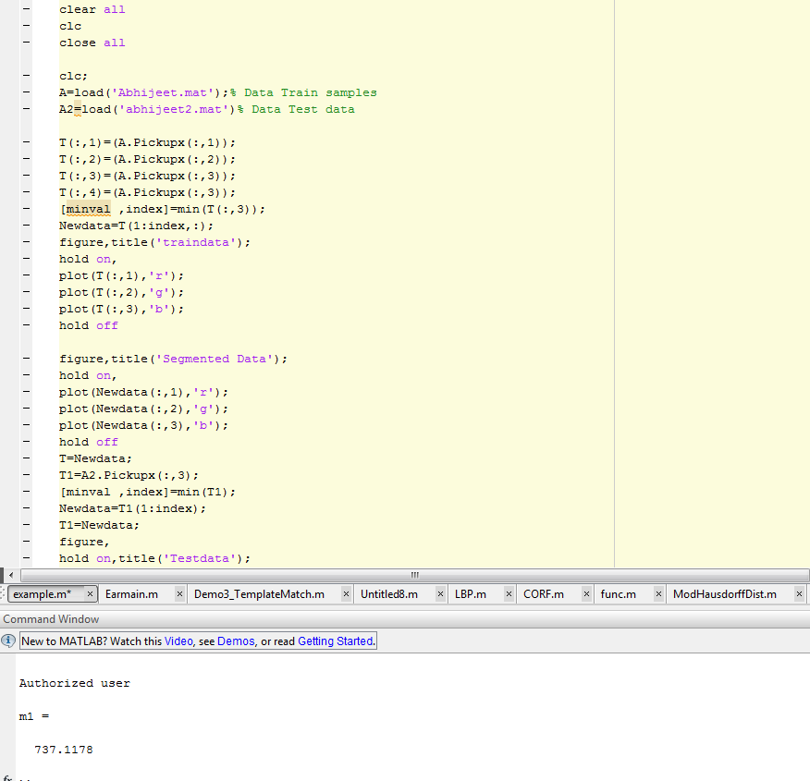
Results:-

Slide 10
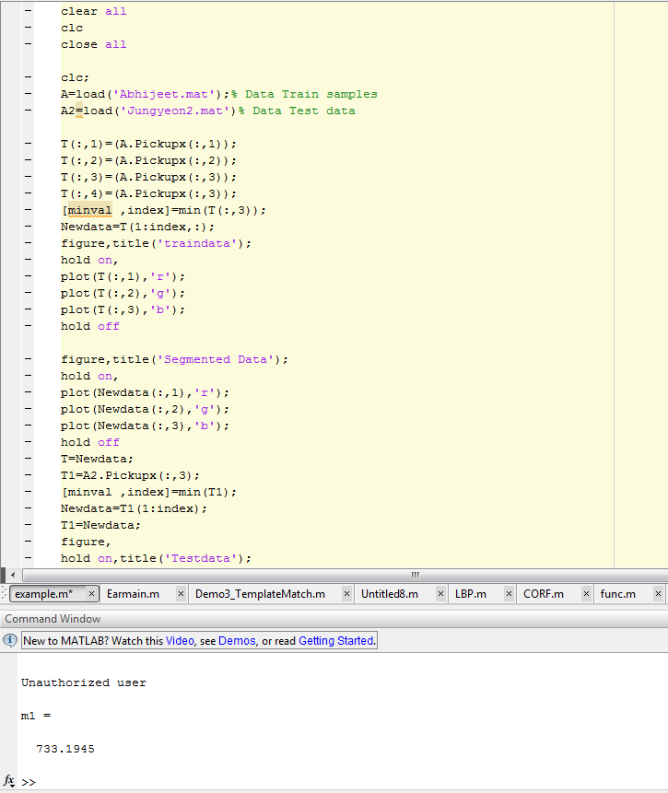
Results:-

Slide 11
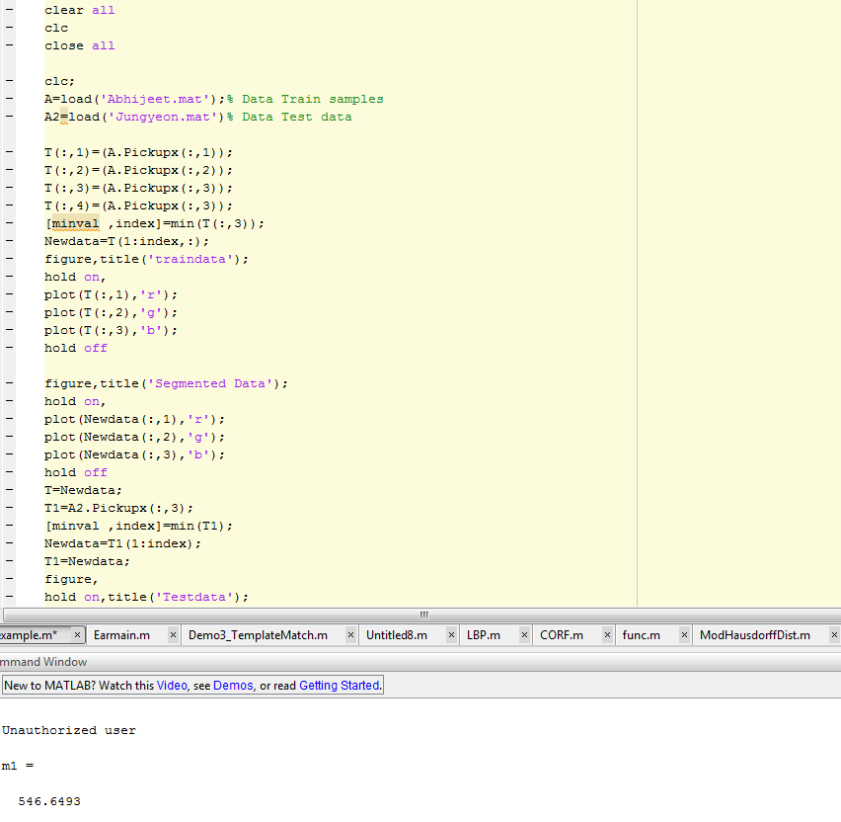
Results:-

Slide 12
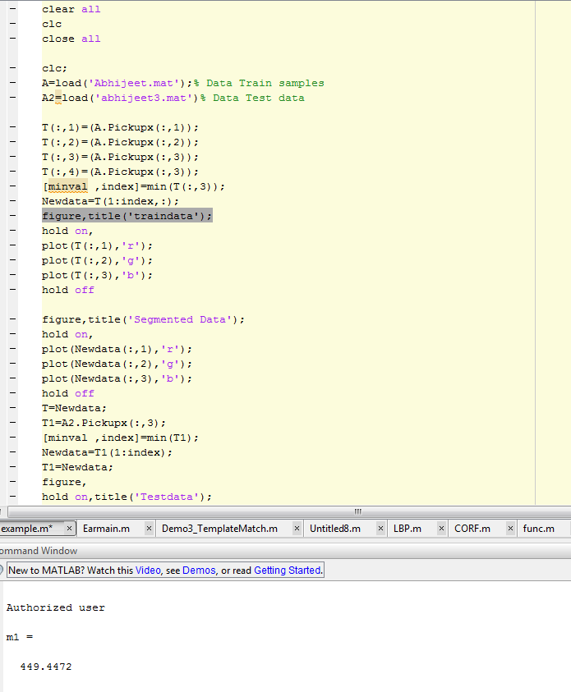
Cross Correlation:-
Results:-

Slide 13
Results:-

Slide 14
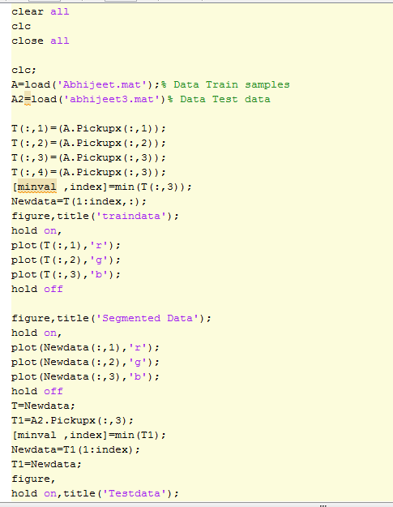
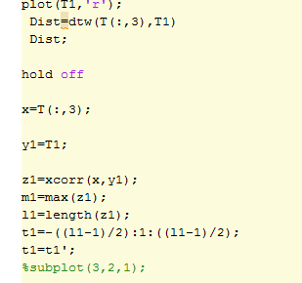
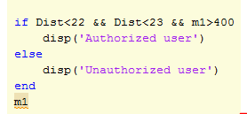
Source Code:-

Slide 15
Ear Image Shaped Recognition using Modified Hausdorff Distance
Abhijeet Borgule
Ubiquitous computing class 2014

Slide 16
Proposed Algorithm:-
Start
Capture Ear Image Photo
Preprocessing
Local Binary Pattern
Image Cropping
Block wise Histogram detection
Hausdorff Distance Matching of Histograms
Training Data
If threshold match
User Authentication Successful
Stop

Slide 17
Algorithm:-
The ear image is captured while call pickup process using smart phone front camera.
The input Image is resized and converted into grayscale.
In this step, Local Binary pattern is applied to the grayscale image.
Then image is divided into 128x128 blocks.
After that each block histogram is calculated.
The Hausdorff Distance is calculated with test LBP image histograms and train image histograms.
The computed point set distance is compared to decided for identification.

Slide 18
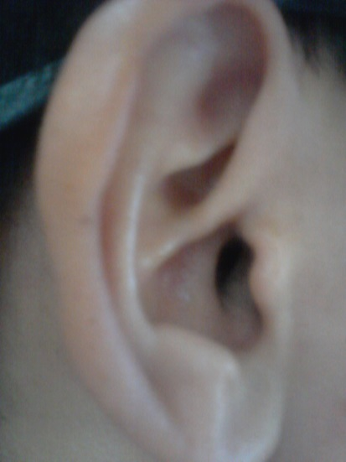
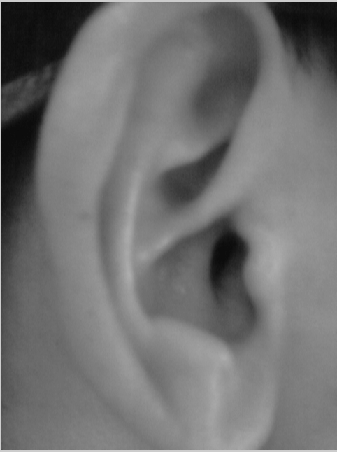
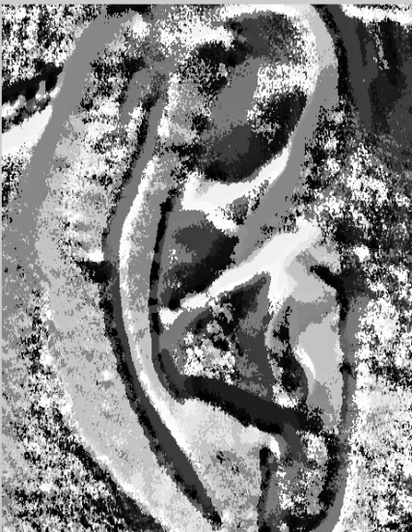

Algorithm:-
Input Image
LBP Image
Grayscale image
Hausdorff Distance
stop
Histograms of LBP blocks
Training Data

Slide 19
Hausdorff Distance
Efficiently compute the Hausdorff Distance between all relative positions of a model and an image.
set A = {a1,….,ap} and B = {b1,….,bq}
Hausdorff distance
Directed Hausdorff distance
h(A,B) ranks each point of A based on its nearest point of B and uses the most mismatched point

Slide 20

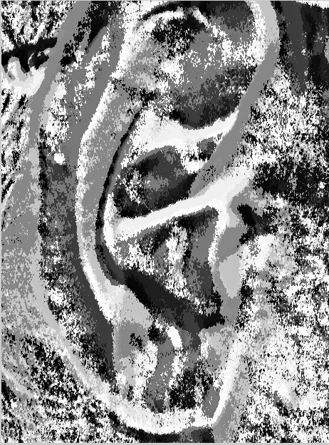
Hausdorff Distance
Lab mate Ear Image
My ear image
for i=1:n
mhd= [mhd ModHausdorffDist(count(:,i,1),count2(:,i,1))];
end
The average distance is computed from the given image.

Slide 21
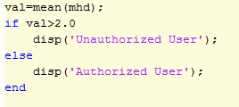
Comparison with threshold method

Slide 22

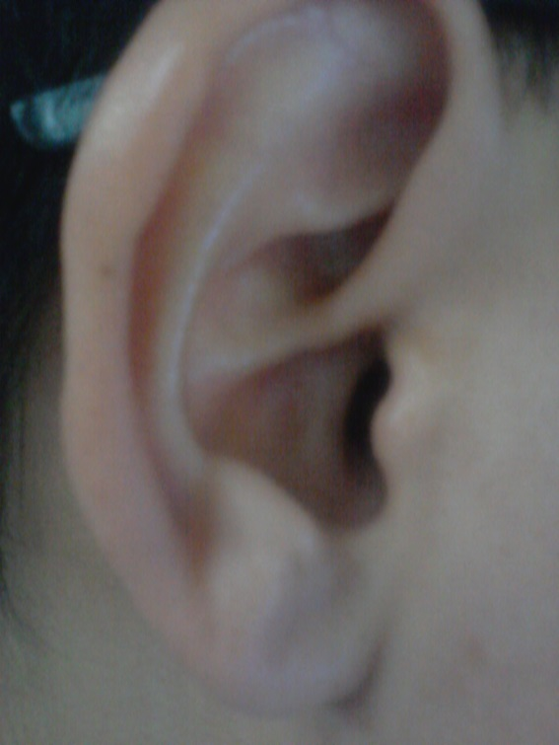
Results:-
Lab mate Ear Train
Lab mate Ear
Test image

Slide 23
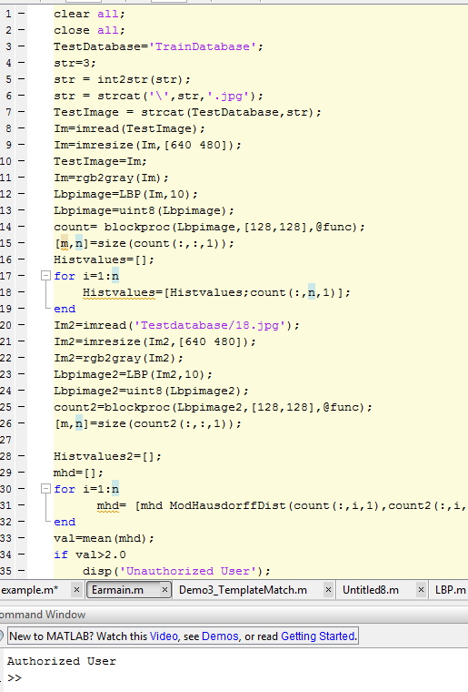
Results:-

Slide 24
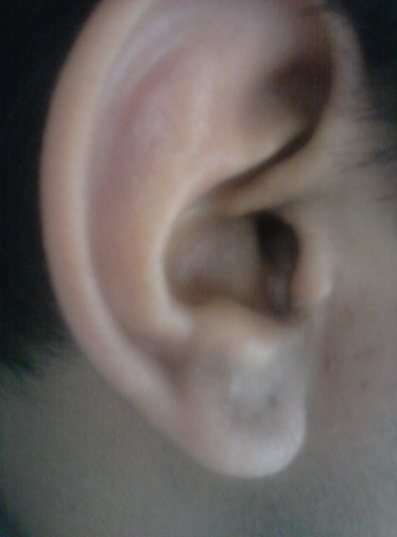
Results:-
Lab mate Ear Train Image
It is my ear
Test image

Slide 25
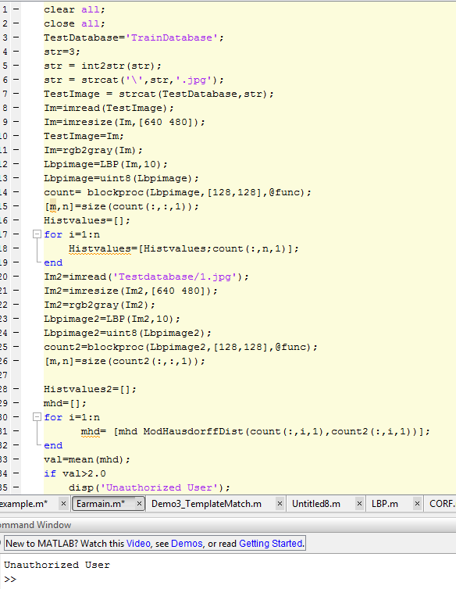
Results:-

Slide 26
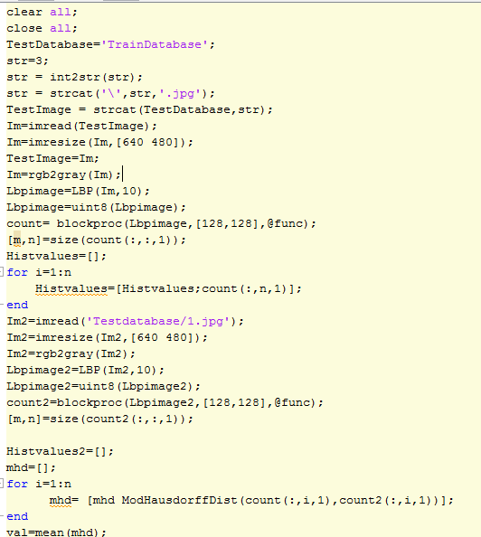
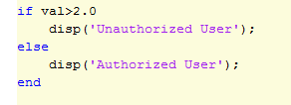
Source Code

Slide 27
Thank You !

